Slide 1

CSE 326: Data Structures
Part 9
Really, Really Hard Problems
Henry Kautz
Autumn Quarter 2002

Slide 2

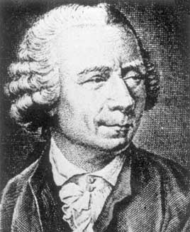
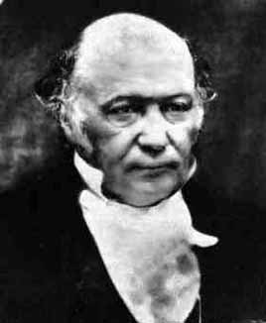
Today’s Agenda
Solving pencil-on-paper puzzles
  A “deep” algorithm for Euler Circuits
Euler with a twist: Hamiltonian circuits
Hamiltonian circuits and NP complete problems
The NP =? P problem
  Your chance to win a Turing award!
  Any takers?
Weiss Chapter 9.7
L. Euler
(1707-1783)
W. R. Hamilton
(1805-1865)
Notes:
Class rule: Interrupt when you don’t understand why we are doing something

Slide 3
It’s Puzzle Time!
Which of these can you draw without lifting your
pencil, drawing each line only once?
Can you start and end at the same point?

Slide 4
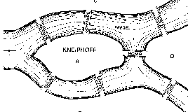
Historical Puzzle: Seven Bridges of Königsberg
PREGEL
KNEIPHOFF
Want to cross all bridges but…
Can cross each bridge only once (High toll to cross twice?!)

Slide 5
A “Multigraph” for the Bridges of Königsberg
Find a path that
traverses every edge
exactly once

Slide 6
Euler Circuits and Tours
Euler tour: a path through a graph that visits each edge exactly once
Euler circuit: an Euler tour that starts and ends at the same vertex
Named after Leonhard Euler (1707-1783), who cracked this problem and founded graph theory in 1736
Some observations for undirected graphs:
  An Euler circuit is only possible if the graph is connected and each vertex has even degree (= # of edges on the vertex) [Why?]
  An Euler tour is only possible if the graph is connected and either all vertices have even degree or exactly two have odd degree [Why?]

Slide 7
Euler Circuits and Tours
Euler tour: a path through a graph that visits each edge exactly once
Euler circuit: an Euler tour that starts and ends at the same vertex
Named after Leonhard Euler (1707-1783), who cracked this problem and founded graph theory in 1736
Some observations for undirected graphs:
  An Euler circuit is only possible if the graph is connected and each vertex has even degree (= # of edges on the vertex)
    Need one edge to get into vertex and one edge to get out
  An Euler tour is only possible if the graph is connected and either all vertices have even degree or exactly two have odd degree
    Could start at one odd vertex and end at the other

Slide 8
Euler Circuit Problem
Problem: Given an undirected graph G = (V,E), find an Euler circuit in G
Note: Can check if one exists in linear time (how?)
Given that an Euler circuit exists, how do we construct an Euler circuit for G?
Hint: Think deep! We’ve discussed the answer in depth before…

Slide 9
Finding Euler Circuits: DFS and then Splice
Given a graph G = (V,E), find an Euler circuit in G
  Can check if one exists in O(|V|) time (check degrees)
Basic Euler Circuit Algorithm:
  Do a depth-first search (DFS) from a vertex until you are back at this vertex
  Pick a vertex on this path with an unused edge and repeat 1.
  Splice all these paths into an Euler circuit
Running time = O(|V| + |E|)

Slide 10
Euler Circuit Example
A
B
C
B
C
G
G
G
D
E
D
E
D
E
F
DFS(A) :
A B D F E C A
DFS(B) :
B G C B
Splice
at G
DFS(G) :
G D E G
Splice at B
A B G C B D F E C A
A B G D E G C B D F E C A

Slide 11
Euler with a Twist: Hamiltonian Circuits
B
C
Euler circuit: A cycle that goes through each edge exactly once
Hamiltonian circuit: A cycle that goes through each vertex exactly once
Does graph I have:
  An Euler circuit?
  A Hamiltonian circuit?
Does graph II have:
  An Euler circuit?
  A Hamiltonian circuit?
G
I
D
E
B
C
G
II
D
E

Slide 12
Finding Hamiltonian Circuits in Graphs
Problem: Find a Hamiltonian circuit in a graph G = (V,E)
  Sub-problem: Does G contain a Hamiltonian circuit?
  No known easy algorithm for checking this…
One solution: Search through all paths to find one that visits each vertex exactly once
  Can use your favorite graph search algorithm (DFS!) to find various paths
This is an exhaustive search (“brute force”) algorithm
Worst case → need to search all paths
  How many paths??

Slide 13
Analysis of our Exhaustive Search Algorithm
B
C
Worst case → need to search all paths
  How many paths?
Can depict these paths as a search tree
Let the average branching factor of each node in this tree be B
|V| vertices, each with ≈ B branches
Total number of paths ≈ B·B·B … ·B
  = O(B^{|V|})
Worst case → Exponential time!
G
D
E
B
D G C
G E D E C G E
Etc.
Search tree of paths from B

Slide 14
How bad is exponential time?
N | log N | N log N | N² | 2^{N}
1 | 0 | 0 | 1 | 2
2 | 1 | 2 | 4 | 4
4 | 2 | 8 | 16 | 16
10 | 3 | 30 | 100 | 1024
100 | 7 | 700 | 10,000 | 1,000,000,000,000,00,000,000,000,000,000
1000 | 10 | 10,000 | 1,000,000 | Fo’gettaboutit!
1,000,000 | 20 | 20,000,000 | 1,000,000,000,000 | ditto

Slide 15
Review: Polynomial versus Exponential Time
Most of our algorithms so far have been O(log N), O(N), O(N log N) or O(N²) running time for inputs of size N
  These are all polynomial time algorithms
  Their running time is O(N^{k}) for some k > 0
Exponential time B^{N} is asymptotically worse than any polynomial function N^{k} for any k
  For any k, N^{k} is Ω(B^{N}) for any constant B > 1

Slide 16
The Complexity Class P
The set P is defined as the set of all problems that can be solved in polynomial worse case time
  Also known as the polynomial time complexity class
  All problems that have some algorithm whose running time is O(N^{k}) for some k
Examples of problems in P: tree search, sorting, shortest path, Euler circuit, etc.

Slide 17
The Complexity Class NP
Definition: NP is the set of all problems for which a given candidate solution can be tested in polynomial time
Example of a problem in NP:
  Hamiltonian circuit problem: Why is it in NP?

Slide 18
The Complexity Class NP
Definition: NP is the set of all problems for which a given candidate solution can be tested in polynomial time
Example of a problem in NP:
  Hamiltonian circuit problem: Why is it in NP?
    Given a candidate path, can test in linear time if it is a Hamiltonian circuit – just check if all vertices are visited exactly once in the candidate path (except start/finish vertex)

Slide 19

Why NP?
NP stands for Nondeterministic Polynomial time
  Why “nondeterministic”? Corresponds to algorithms that can guess a solution (if it exists) → the solution is then verified to be correct in polynomial time
  Nondeterministic algorithms don’t exist – purely theoretical idea invented to understand how hard a problem could be
Examples of problems in NP:
  Hamiltonian circuit: Given a candidate path, can test in linear time if it is a Hamiltonian circuit
  Sorting: Can test in linear time if a candidate ordering is sorted
  Are any other problems in P also in NP?

Slide 20
More Revelations About NP
Are any other problems in P also in NP?
  YES! All problems in P are also in NP
    Notation: P ⊆ NP
    If you can solve a problem in polynomial time, can definitely verify a solution in polynomial time
Question: Are all problems in NP also in P?
  Is NP ⊆ P?

Slide 21

Your Chance to Win a Turing Award: P = NP?
Nobody knows whether NP ⊆ P
  Proving or disproving this will bring you instant fame!
It is generally believed that P ≠ NP, i.e. there are problems in NP that are not in P
  But no one has been able to show even one such problem!
  Practically all of modern complexity theory is premised on the assumption that P ≠ NP
A very large number of useful problems are in NP
Alan Turing
(1912-1954)

Slide 22
NP-Complete Problems
The “hardest” problems in NP are called NP-complete problems (NPC)
Why “hardest”? A problem X is NP-complete iff:
    X is in NP and
    Any problem Y in NP can be converted to an instance of X in polynomial time, such that solving X also provides a solution for Y
    In other words: Can use algorithm for X as a subroutine to solve Y
Thus, if you find a poly time algorithm for just one NPC problem, all problems in NP can be solved in poly time
  E.g: The Hamiltonian circuit problem can be shown to be NP-complete

Slide 23
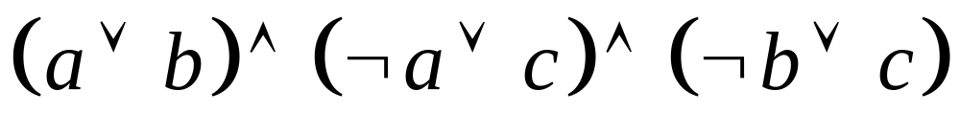
My Favorite NP-Complete Problem
SAT: Given a formula in Boolean logic, e.g.
determine if there is an assignment of values to the variables that makes the formula true (=1).
Why is it in NP?

Slide 24

Why SAT is NP-Complete
Cook (1971) showed that SAT could be used to simulate any non-deterministic Turing machine!
Idea: consider the tree of possible execution states of the Turing machine
  A Boolean logic formula can represent this tree – the “state transition” function
  Formula also asserts the final state is one where a solution has been found
  “Guessed” variables determine which branch to take

Slide 25
P, NP, and Exponential Time Problems
All currently known algorithms for NP-complete problems run in exponential worst case time
  Finding a polynomial time algorithm for any NPC problem would mean:
Diagram depicts relationship between P, NP, and EXPTIME (class of problems that provably require exponential time to solve)
EXPTIME
NPC
NP
P
It is believed that
P ≠ NP ≠ EXPTIME

Slide 26
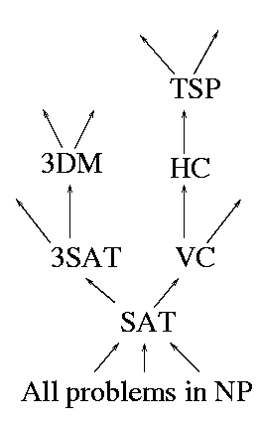
The Graph of NP-Completeness
Stephen Cook first showed (1971) that satisfiability of Boolean formulas (SAT) is NP-complete
Hundreds of other problems (from scheduling and databases to optimization theory) have since been shown to be NPC
How? By showing an algorithm that converts a known NPC problem to your pet problem in poly time → then, your problem is also NPC!

Slide 27
Showing NP-completeness: An example
Consider the Traveling Salesperson (TSP) Problem: Given a fully connected, weighted graph G = (V,E), is there a cycle that visits all vertices exactly once and has total cost ≤ K?
TSP is in NP (why?)
Can we show TSP is NP-complete?
  Hamiltonian Circuit (HC) is NPC
  Can show TSP is also NPC if we can convert any input for HC to an input for TSP in poly time
B
4
C
1
Cycle
with cost
8 →
BDCEB
3
2
1
D
3
E
B
C
Convert
to input
for TSP
G
D
E
Input for HC

Slide 28
TSP is NP-complete!
We can show TSP is also NPC if we can convert any input for HC to an input for TSP in polynomial time. Here’s one way:
1
B
C
B
C
1
1
HC
G
TSP
G
1
1
1
1
D
E
2
D
1
E
2
This graph has a Hamiltonian circuit iff this fully-connected graph
has a TSP cycle of total cost ≤ K, where K = |V| (here, K = 5)

Slide 29
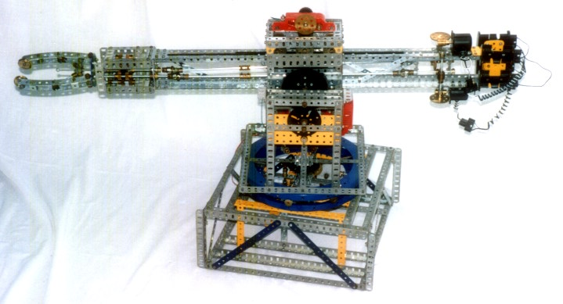
Searching Really Big Graphs
Any kind of search (DFS, BFS, A*) is polynomial in the size of the graph (number of vertices)
But a search problem might be NP-complete in terms of a small description of a very large graph
Example: Blocks World
  O(|V|) to find a shortest path between any two vertices
  But if given only the initial and final states (size of these descriptions is ≈ number of blocks), problem is NP-complete

Slide 30
Longest Path
Decision problem version: Is there a simple path in G (between two given vertices s and t) of length at least k?
Clearly in NP. Why?
To prove the longest path problem is NP-complete,we can again reduce Hamiltonian circuit problem
  Input: a HC problem G with n vertices
  Duplicate some vertex s in G, call it t
  Add an edge of weight 0 between s and t
  Ask longest path: is there a path of at least weight n between s and t?

Slide 31
Coping with NP-Completeness
  Settle for algorithms that are fast on average: Worst case still takes exponential time, but doesn’t occur very often.
    But some NP-Complete problems are also average-time NP-Complete!
  Settle for fast algorithms that give near-optimal solutions: In TSP, may not give the cheapest tour, but maybe good enough.
    But finding even approximate solutions to some NP-Complete problems is NP-Complete!
  Just get the exponent as low as possible! Much work on exponential algorithms for Boolean satisfiability: in practice can often solve problems with 1,000+ variables
    But even 2^{n/100} will eventual hit the exponential curve!

Slide 32
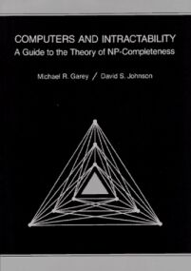
A Great Book You Should Own!
Computers and Intractability: A Guide to the Theory of NP-Completeness, by Michael S. Garey and David S. Johnson

Slide 33
Coming Up
Solving SAT
Quad trees, Treaps, and Skip Lists
Maze runner runoffs

